Slide 1
Azure Project
Submitted by,
SHANTI ANNA VARGHESE
ID:214427
EMAIL: 214427@ust-global.com

Slide 2
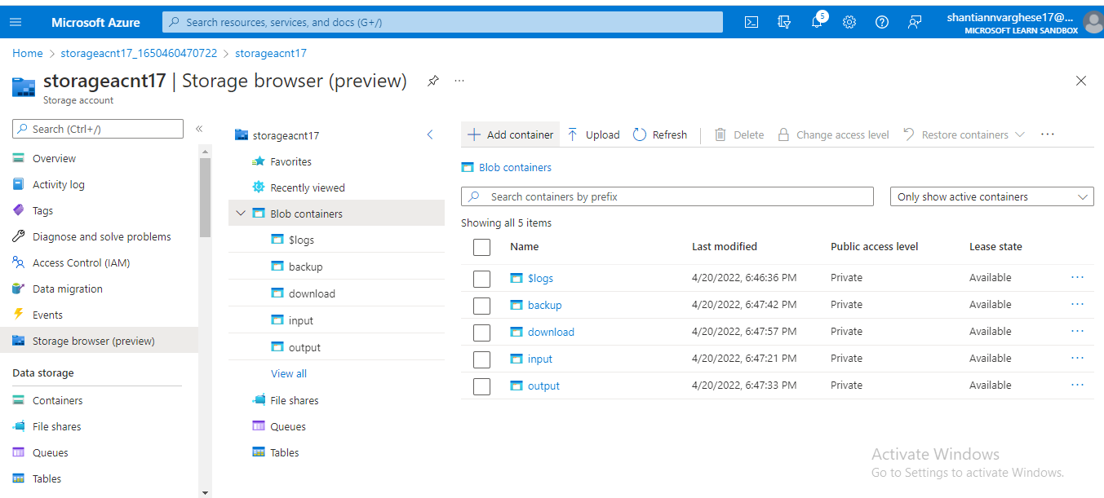
Storage Account in Azure with 4 containers

Slide 3
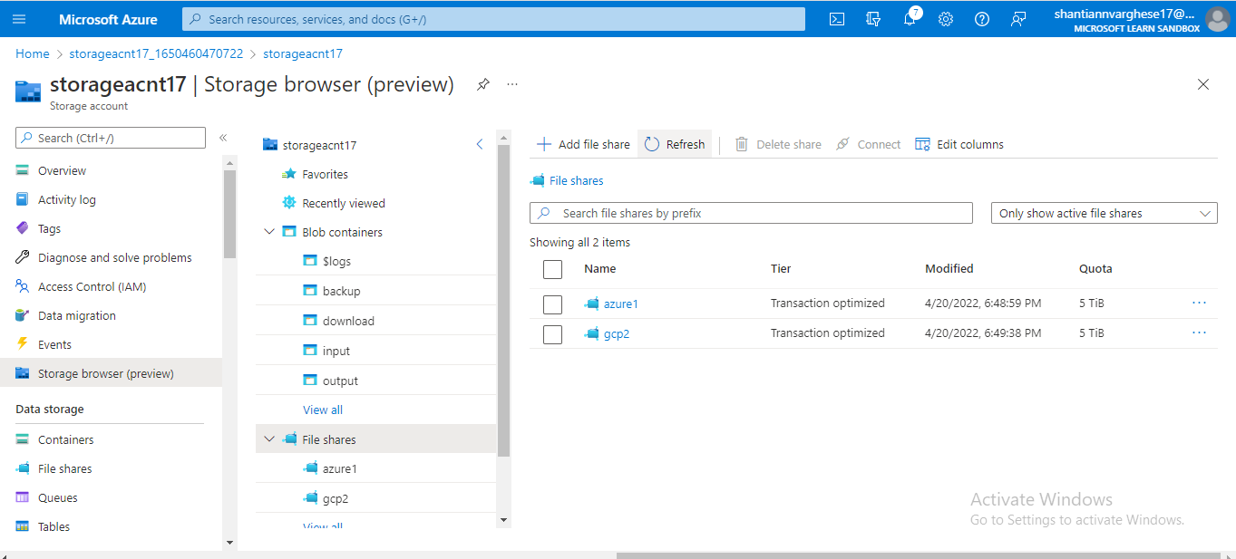
File Share with 2 directories

Slide 4
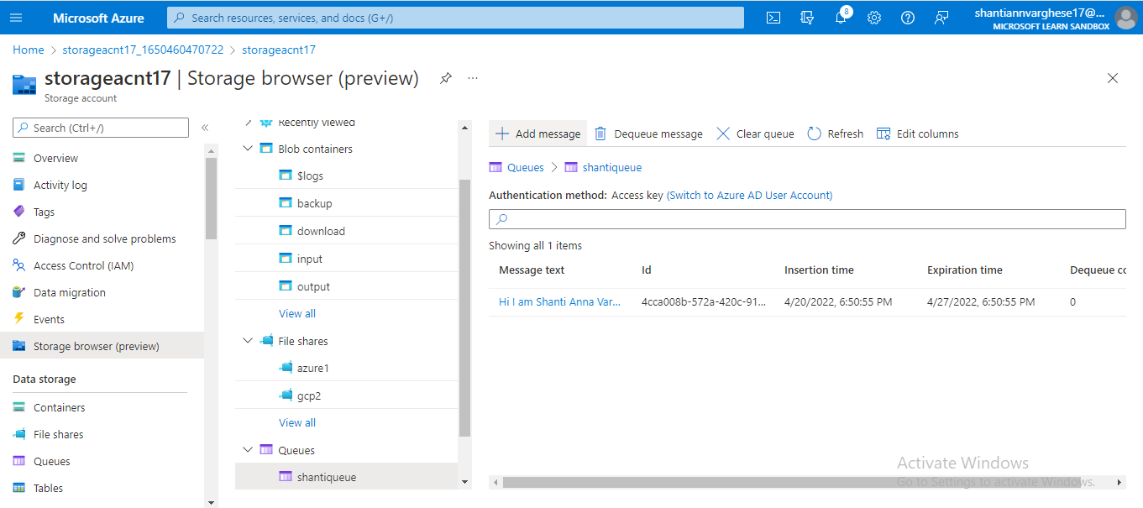
Message Queue with a message

Slide 5
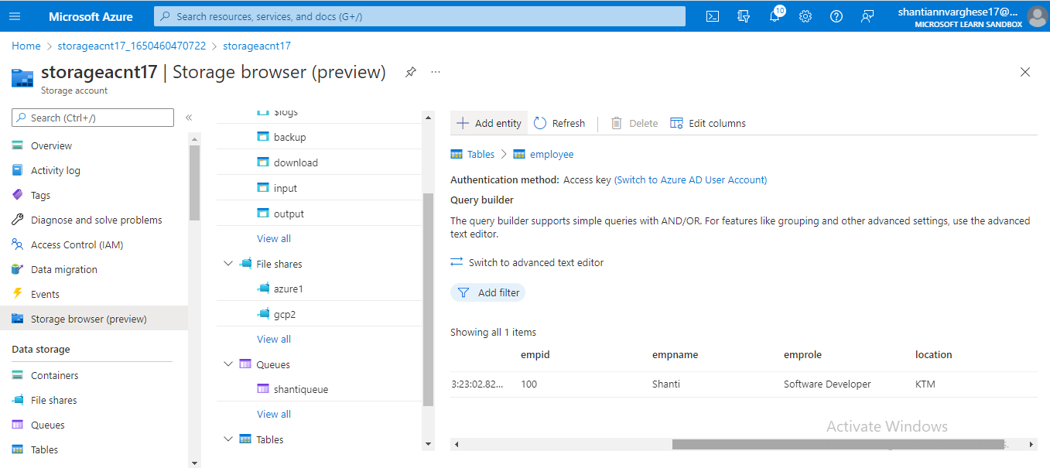
Table

Slide 6
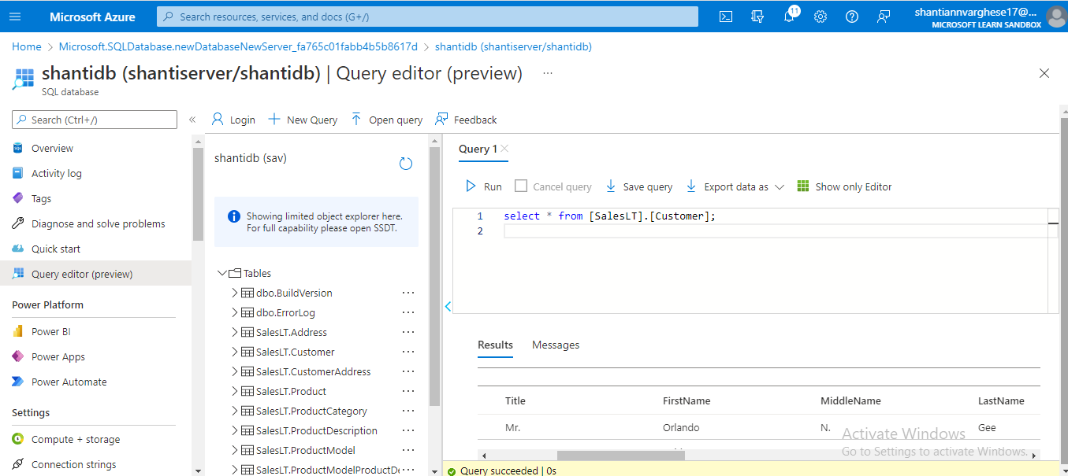
Sample Database with query

Slide 7
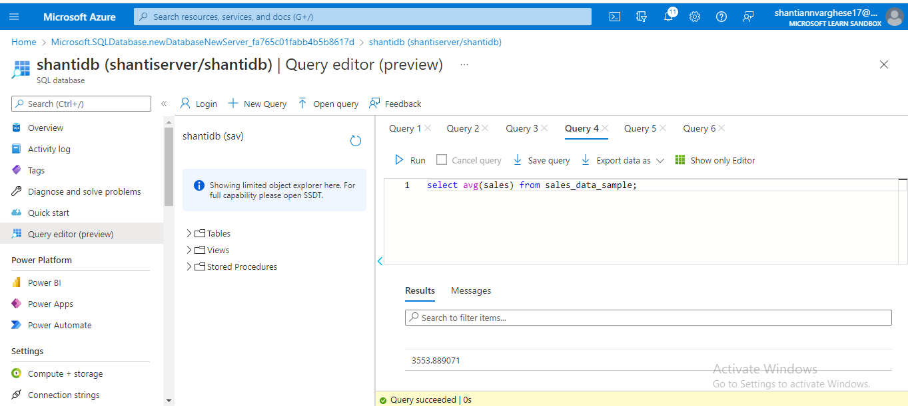
Sample Database with Dimensions & Fact Tables- To estimate the unit sales of retail goods

Slide 8
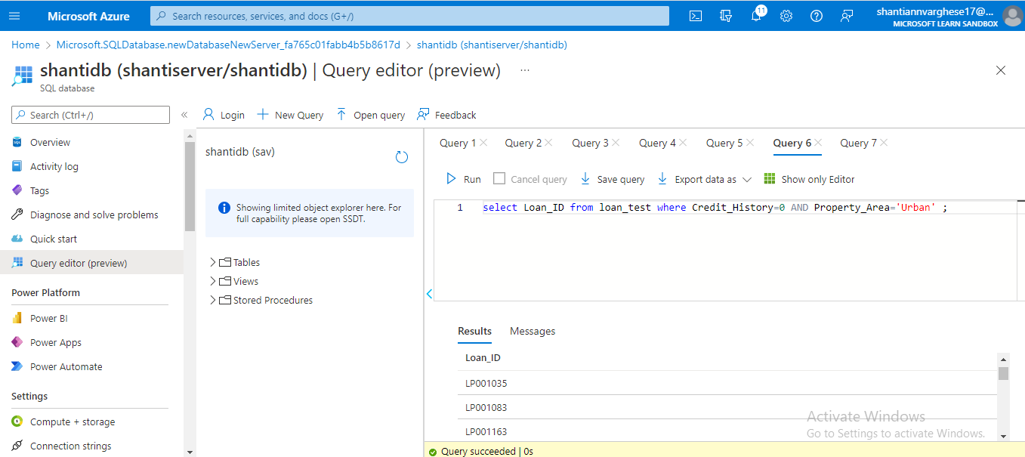
Sample Database with Dimensions & Fact Tables- Financial Need Programs for Consumer Loan Products

Slide 9
THANK YOU

